Slide 1
Classification for the Graduate Admissions Analysis

Slide 2
Admissions Data
What is our goal with the admissions data?
Determine who is in and who is out.

Slide 3
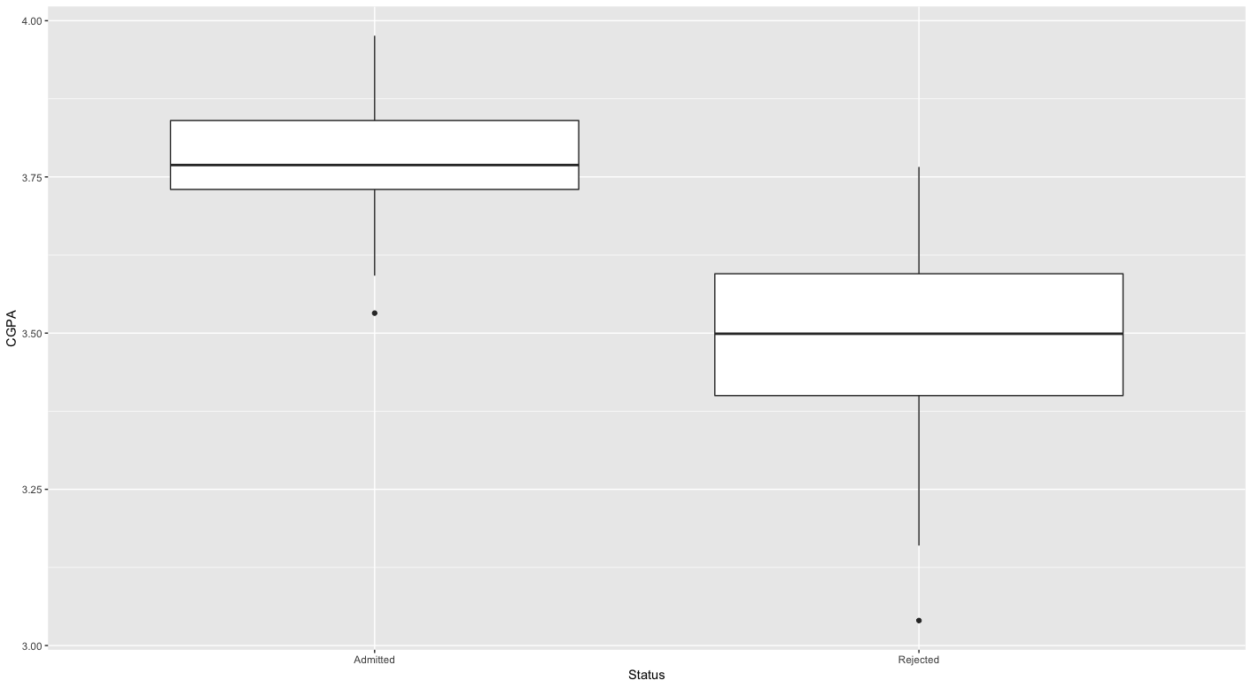
Admissions Data

Slide 4
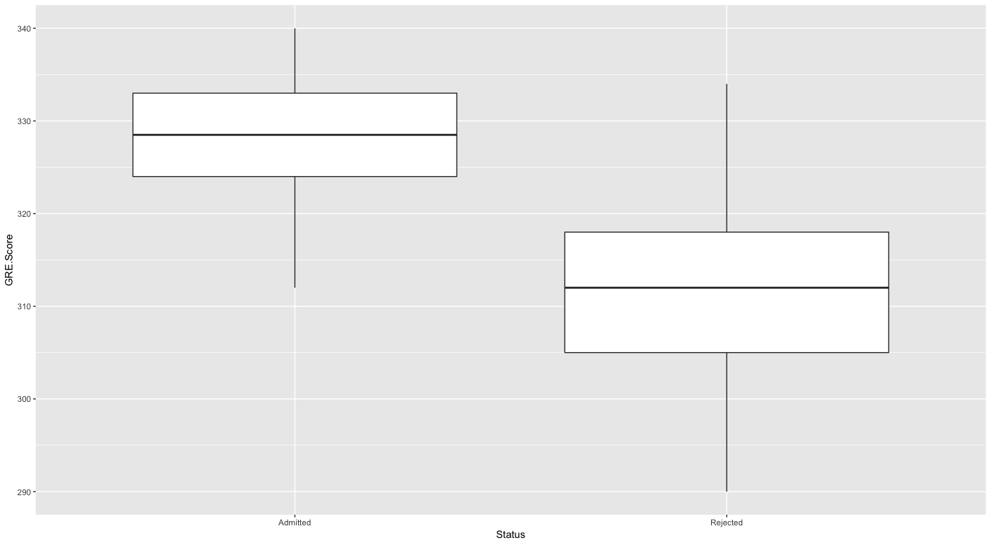
Admissions Data

Slide 5
Admissions Data
Letters of Recommendation

Slide 6
Admissions Data Analysis
What are the challenges with the Admission data?
0/1 Categorical Response.
Lots of variables (fine line b/n quantitative and categorical).
Perhaps non-linear relationship
Possible Approaches:
Logistic Regression (last dataset so don’t use here)
Probit Regression (last dataset so don’t use here)
K-Nearest Neighbors
Discriminant Analysis
Support Vector Machines
Neural Networks
Classification Trees

Slide 7
K-Nearest Neighbors
K-Nearest Neighbors Algorithm (Non-parametric):
To classify a point which has covariates
Find the K-nearest neighbors according to some distance
Approximate,
where is the set of K nearest points.
Classify according to majority vote.

Slide 8
K-Nearest Neighbors
Issues:
What distance, , should we use?
Euclidean – does this make sense for categorical variables?
Mahalanobis -
What value should we use for K?
Use Cross-validation
Scale Matters! At least center and scale first

Slide 9
K-Nearest Neighbors
Coding Issues:
The knn() function the book recommends only allows Euclidean distance. If you standardize and decorrelate first then Euclidean = Mahalanobis
X <- fastDummies::dummy_cols(dataframe)
X <- scale(X)
X <- X%*%solve(chol(cov(X)))

Slide 10
Discriminant Analysis
Bayes Theorem for Classification:
New Idea: Assume is random and factor the joint distribution
Using Bayes Theorem:

Slide 11
Discriminant Analysis
Discriminant Analysis Classification: Assign to the class that maximizes,
Note: Technically, this is “quadratic” discriminant analysis. “Linear” discriminant analysis assumes

Slide 12
Naïve Bayes
Naïve Bayes Classification: A special type of discriminant analysis where each explanatory variable is independent. The joint distribution can then be factored as
Note: In naïve Bayes, if x_{p} is quantitative then is Gaussian and if x_{p} is categorical then is multinomial.

Slide 13
Discriminant Analysis
Discriminant Analysis Classification:
Issues:
What do we use for

Slide 14
Discriminant Analysis
Discriminant Analysis Classification:
Issues:
What happens if we don’t have Gaussian distributed explanatory variables?
Use kernel density estimates of the distribution

Slide 15
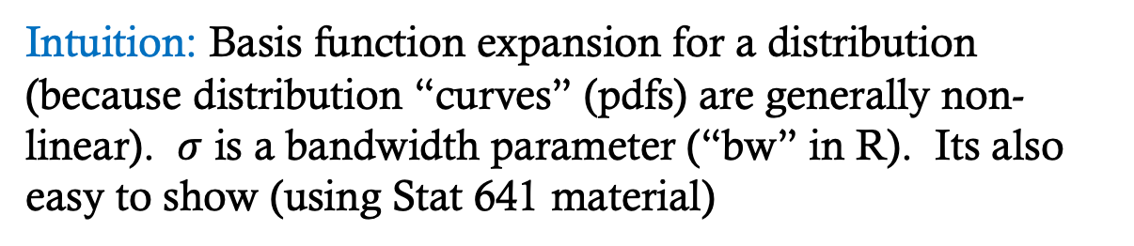
Discriminant Analysis
Kernel Density Estimation (i.e. what density() is doing):
is called a “kernel” if
Intuition: Basis function expansion for a distribution (because distribution “curves” (pdfs) are generally non-linear). $σ$ is a bandwidth parameter (“bw” in R). Its also easy to show (using Stat 641 material)

Slide 16
Discriminant Analysis
Discriminant Analysis Classification:
Issues:
What happens if we have categorical variables?
Use a multinomial distribution

Slide 17
Support Vector Machines
Maximal Margin Hyperplane: Plane that maximizes orthogonal distance from observations to plane.

Slide 18
Support Vector Machines
Building Block #1: Separating Hyperplanes
Hyperplane: A flat subset with dimension
In a point.
In a line.
In a plane
Mathematically:
Divides the -dimensional space in two. For example, if
then the point is “above” the hyperplane. Otherwise, its “below” the hyperplane.

Slide 19
Support Vector Machines
Building Block #1: Separating Hyperplanes
For , let
Also, if
so you’re “above” the line.

Slide 20
Support Vector Machines
Building Block #1: Separating Hyperplanes
Big Idea: Find a hyperplane that separates the different classes.
Let , rather than We want to find a hyperplane such that,
The classification rule becomes:
and, magnitude of becomes how far away a point is from the hyperplane. The function is referred to as the classifier (or classifying function).

Slide 21
Support Vector Machines
Building Block #1: Separating Hyperplanes
Issues with finding separating hyperplanes:
If such a plane does exist, there are infinitely many of them.

Slide 22
Support Vector Machines
Maximal Margin Hyperplane: Plane that maximizes orthogonal distance from observations to plane.

Slide 23
Support Vector Machines
Maximal Margin Hyperplane: Plane that maximizes orthogonal distance from observations to plane.
Support Vectors
Margin

Slide 24
Support Vector Machines
Maximal Margin Hyperplane: Plane that maximizes orthogonal distance from observations to plane.
Recall, the perpendicular distance from a dot to a hyperplane is
Mathematically, find the hyperplane that
Maximum margin
Ensures points are on the “right” side of the hyperplane.

Slide 25
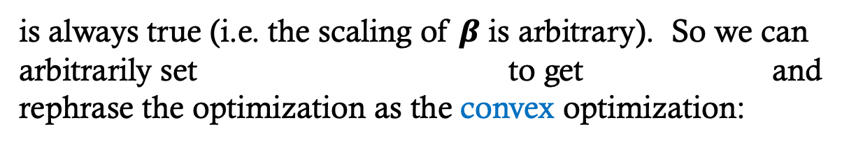
Support Vector Machines
Calculating the Maximal Margin Hyperplane: For all separating hyperplanes the condition
is always true (i.e. the scaling of $β$ is arbitrary). So we can arbitrarily set to get and rephrase the optimization as the convex optimization:

Slide 26
Support Vector Machines
Calculating the Maximal Margin Hyperplane: The Lagrange equation to be minimized is then:
which has the solution (ugly to show – Lagrange dualities):
so that:

Slide 27
Support Vector Machines
Building Block #1: Separating Hyperplanes
Issues with finding separating hyperplanes:
If such a plane does exists, there are infinitely many of them – use maximum margin hyperplane.
Separating hyperplanes, essentially, don’t exist for real data.

Slide 28
Support Vector Machines
Building Block #2: Support Vector Classifier
Big Idea: Find a hyperplane that “almost” separates the classes.
“Slack Variables”
Tuning “Budget” Parameter

Slide 29
Support Vector Machines
Building Block #2: Support Vector Classifier
Margin = M
Slack Variables -___

Slide 30
Support Vector Machines
Building Block #2: Support Vector Classifier
Margin = M
Slack Variables -___

Slide 31
Support Vector Machines
Building Block #2: Support Vector Classifier
Margin = M
Slack Variables -___

Slide 32
Support Vector Machines
Building Block #2: Support Vector Classifier
Tuning Parameter -_B_

Slide 33
Support Vector Machines
Building Block #2: Reworking the optimization problem as in the separating hyperplane example, we want:
Which is equivalent to:

Slide 34
Support Vector Machines
Building Block #2: The SVM solution (ugly to show):
Only depends upon inner products w/support vectors!

Slide 35
Support Vector Machines
Support Vector Machines:
Big Idea: A plane, literally, just won’t cut it! Need something non-linear.

Slide 36
Support Vector Machines
Support Vector Machines:
Big Realization: Recall a hyperplane only depends on support vectors and can be written using dot-products:
which is a linear function. So, perform a basis function expansion to get non-linear surface:

Slide 37
Support Vector Machines
Support Vector Machines: The “Kernel” Trick
Kernels are positive semi-definite functions that, effectively, do a basis expansion but are computationally easy. For example, if P = 2 and we use 2nd degree polynomial kernel then:

Slide 38
Support Vector Machines
Support Vector Machines: The “Kernel” Trick
Common Choices of Kernels:

Slide 39
Support Vector Machines
Support Vector Machines:
Issues:
Results change a lot depending on kernel (basis function).
Polynomial
Radial

Slide 40
Support Vector Machines
Support Vector Machines:
Issues:
Tuning Parameter (B) chosen via cross-validation.

Slide 41
Support Vector Machines
Support Vector Machines:
Issues:
Yes/No output rather than probabilities.
Solution is to calibrate probabilities (more on this in a few slides)

Slide 42
Classification (and Regression) Trees - CART

Slide 43
Classification (and Regression) Trees - CART
Big Idea:
Divide predictor space into T non-overlapping regions
For any make the same prediction.
Estimate:

Slide 44
Classification (and Regression) Trees - CART
Estimators:
Regression Trees:
Classification Trees:

Slide 45
Classification (and Regression) Trees - CART
Growing a Tree: Recursive Binary Splitting
Find a predictor and a cut point such that splitting space into and leads to greatest reduction in error.
Repeat step 1 repeatedly but only split previously defined regions.

Slide 46
Classification (and Regression) Trees - CART
Growing a Tree: Find regions that minimize:
Controls Overfitting
Regression Trees:

Slide 47
Classification (and Regression) Trees - CART
Growing a Tree: Find regions that minimize:
Classification Trees:

Slide 48
Classification (and Regression) Trees - CART
Growing a Tree: A few notes
Computationally simpler to build a big tree then “prune” it back to minimize:
Default in R is to build a big tree, you need to prune it yourself.
How do you choose ?
Cross-validation

Slide 49
A Few Notes on Coding Trees
Coding for Trees
Your book has you use the tree library in R but I have run into funny results with that library (from what I can tell it rounds your misclassification which prevents you being unable to tell which model is better).
I like to use the rpart library and there is a nice vignette on how to use it at: www.statmethods.net/advstats/cart.html (or just google “trees in R” and it comes up as Quick R: Tree-based Methods)
Both the tree and rpart libraries have default settings that prevent trees from growing too big but I don’t like the defaults (too conservative). So, I’d recommend setting rpart.control(cp=0) or tree.control(mindev=0) and then prune it back. See the R documentation on rpart.control or tree.control for more details.

Slide 50
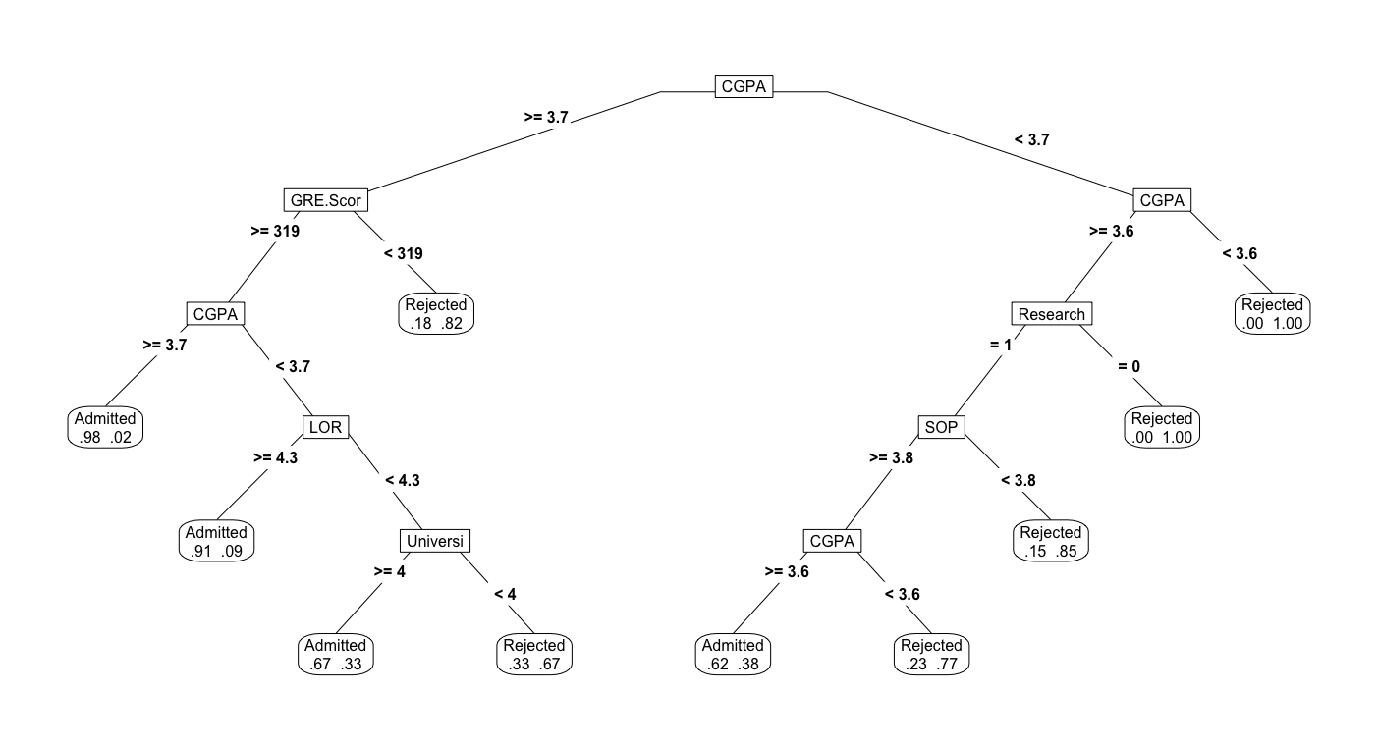
A Few Notes on Coding Trees
Coding for Trees
Much prettier trees can be drawn using library(rpart.plot) and the prp() function (which stands for “plot r part”)

Slide 51
Ensemble Methods

Slide 52
But first: The Bootstrap
Bootstrap Algorithm (Repeat MANY times):
For where B is large
Take a “bootstrap sample” of size K from the original n data points with replacement.
Calculate and retain (or any other quantity you’re interested in, e.g., a prediction).
Theory tells us

Slide 53
The Bootstrap
Bootstrapped Confidence Intervals:
Quantile Interval:
Centered Interval: If then

Slide 54
The Bootstrap

Slide 55
Bagging
Disadvantage of Trees: High variance
Solution: Bootstrap Aggregating (Bagging)
Motivating Problem:
Big Idea: Average Trees

Slide 56
Bagging
Bagging Algorithm:
For
Take a bootstrapped (with replacement) sample of size
Build a tree .
To predict for a point
For , pass down the tree to get a bootstrapped prediction .
Average predictions to get
Reg. Trees
Class. Tree – “majority vote”

Slide 57
Bagging
Why bagging is brilliant:
Bagging decreases variance so we can overfit our bootstrapped data.
Grow large trees (low bias) and the aggregate them.

Slide 58
Bagging
Why bagging is brilliant:
Eliminates the need to do cross validation.
Out-of-bag Error Estimation:
“In-bag” points: Obs. in the bootstrap sample.
“Out-of-bag” points: Obs. not in the bootstrap sample.
Use that were built where observation was out-of-bag to predict This is equivalent to a “hold-out” prediction that can be used to calculate misclassification error or MSE.

Slide 59
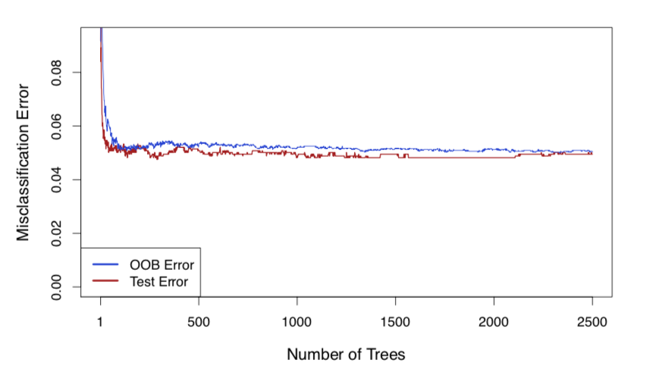
Bagging
Why bagging is brilliant:
Eliminates the need to do cross validation.

Slide 60
Bagging
Why bagging is brilliant:
Performs variable selection.
Downside: Hard to interpret because we are using many trees.
Solution: Look at how much MSE (or misclassification) is decreased when a variable is used. Rank variables according to how much they reduced error.
Note: In R it gives you how much MSE would increase if the variable would be left out (bigger = more important).

Slide 61
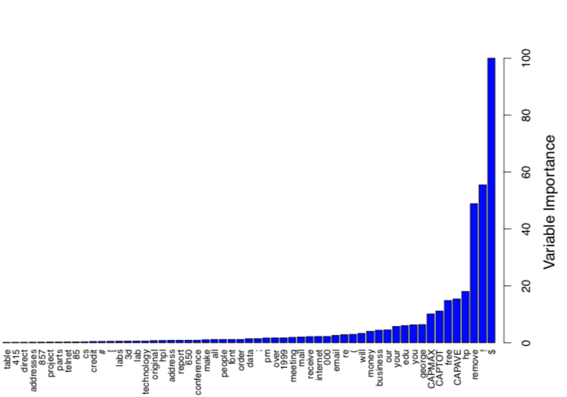
Bagging
Why bagging is brilliant:
Performs variable selection.

Slide 62
Bagging
Why bagging is brilliant:
Its not just for trees – any method can be bagged.

Slide 63
Random Forests
Motivating Problem
Generally, when observations are positively correlated,
Independent obs. have more information than correlated obs.

Slide 64
Random Forests
Random Forest Algorithm:
For
Take a bootstrapped (with replacement) sample of size
At each split, randomly consider vars
Build a tree .
To predict for a point
For , pass down the tree to get a bootstrapped prediction .
Average predictions to get
Reg. Trees
Class. Tree – “majority vote”

Slide 65
Random Forests
Random Forest Intuition:
Selecting only predictors to build a tree, “decorrelates” the trees.
Also, each tree models a different aspect of the data
If then random forests = bagging.
What value do we use for
It depends on how correlated your predictors are.
Book suggests
Cross validation

Slide 66
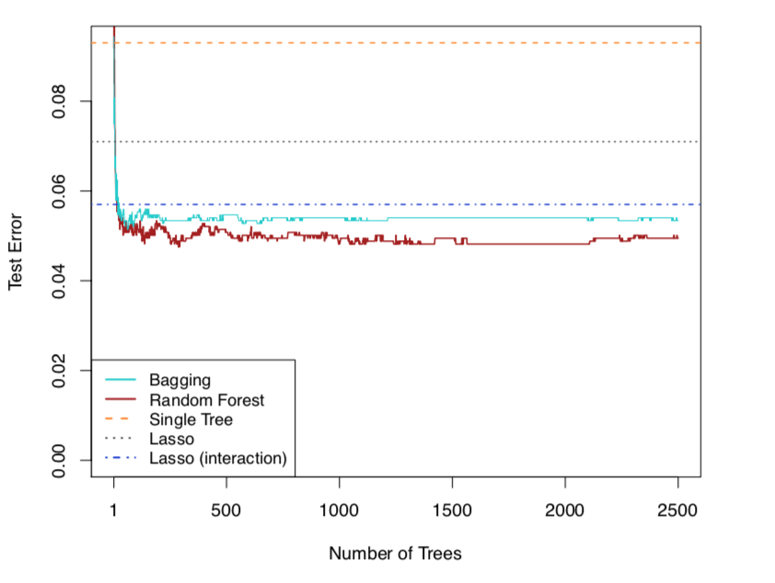
Random Forests
Random Forest Tuning Parameters:
m
# trees (each tree grown deeply)

Slide 67
Random Forests
Coding Notes:
The book uses the randomForest library which is fine but the ranger library has faster implementation. The syntax is essentially identical.

Slide 68
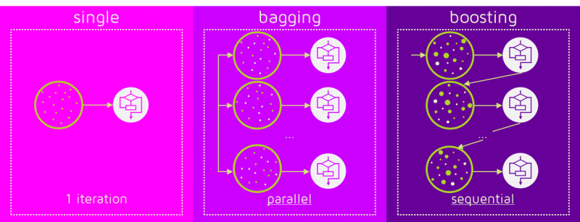
Boosting

Slide 69
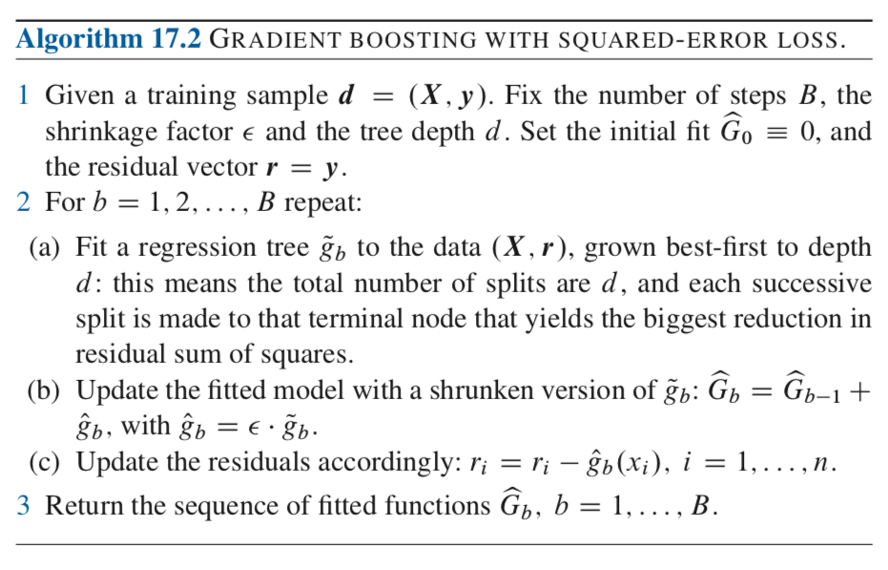
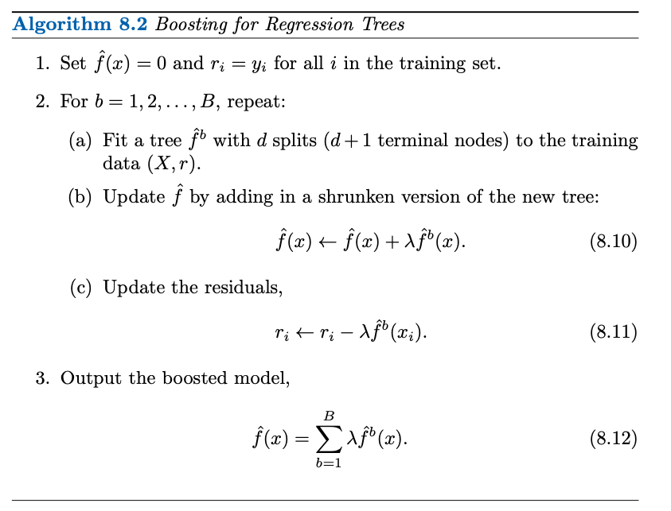
Boosting (Weak Learners)
Quantitative Response: Fit trees sequentially to residuals – each tree fits the part of the data that previous trees didn’t capture.
Tuning parameters

Slide 70
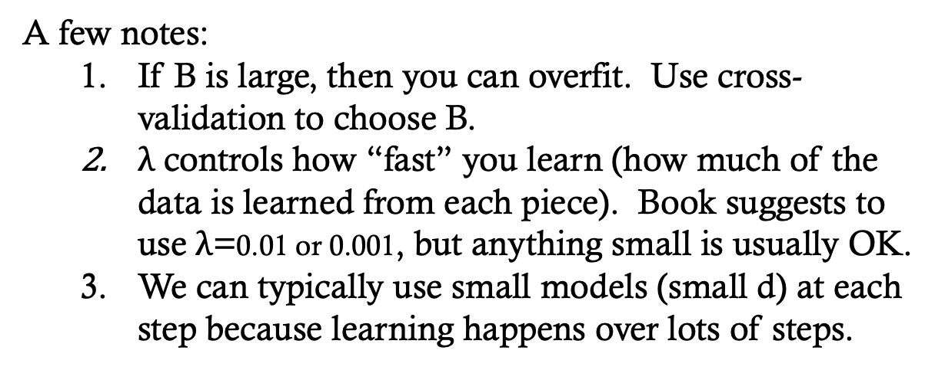
Boosting (Weak Learners)
Intuition of Boosting:
Rather than using many trees which capture the same features of the data (bagging, random forests), use many trees which capture different aspects of the data.
A few notes:
If B is large, then you can overfit. Use cross-validation to choose B.
$λ$ controls how “fast” you learn (how much of the data is learned from each piece). Book suggests to use $λ$=0.01 or 0.001, but anything small is usually OK.
We can typically use small models (small d) at each step because learning happens over lots of steps.

Slide 71
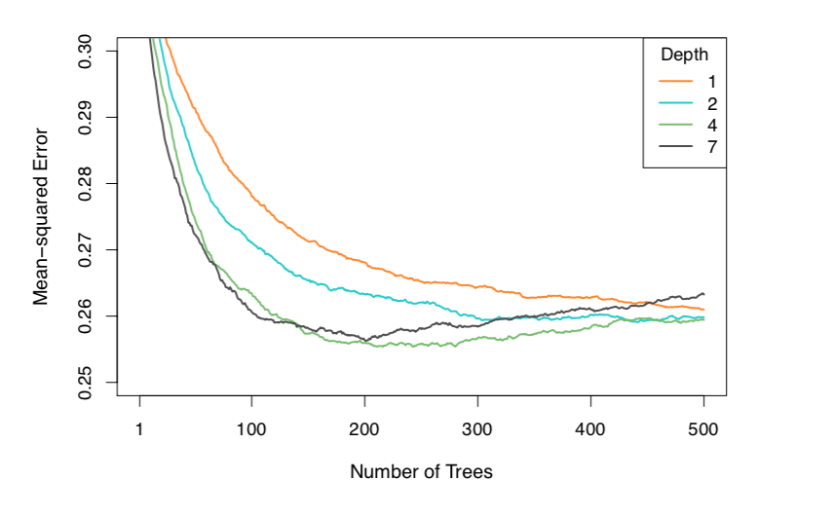
Boosting (Weak Learners)

Slide 72
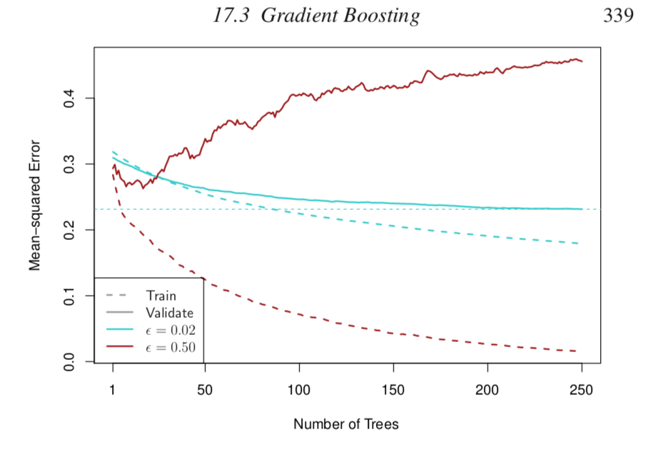
Boosting (Weak Learners)

Slide 73
Boosting (Weak Learners)
Boosting for Non-Quantitative Responses:
Sequentially estimate the natural parameter
You will get into natural parameters a lot more in Stat 637 (Berrett) but, in general, it’s a transformation of the parameter to the whole real line (link function).
Binomial:
Multinomial:

Slide 74
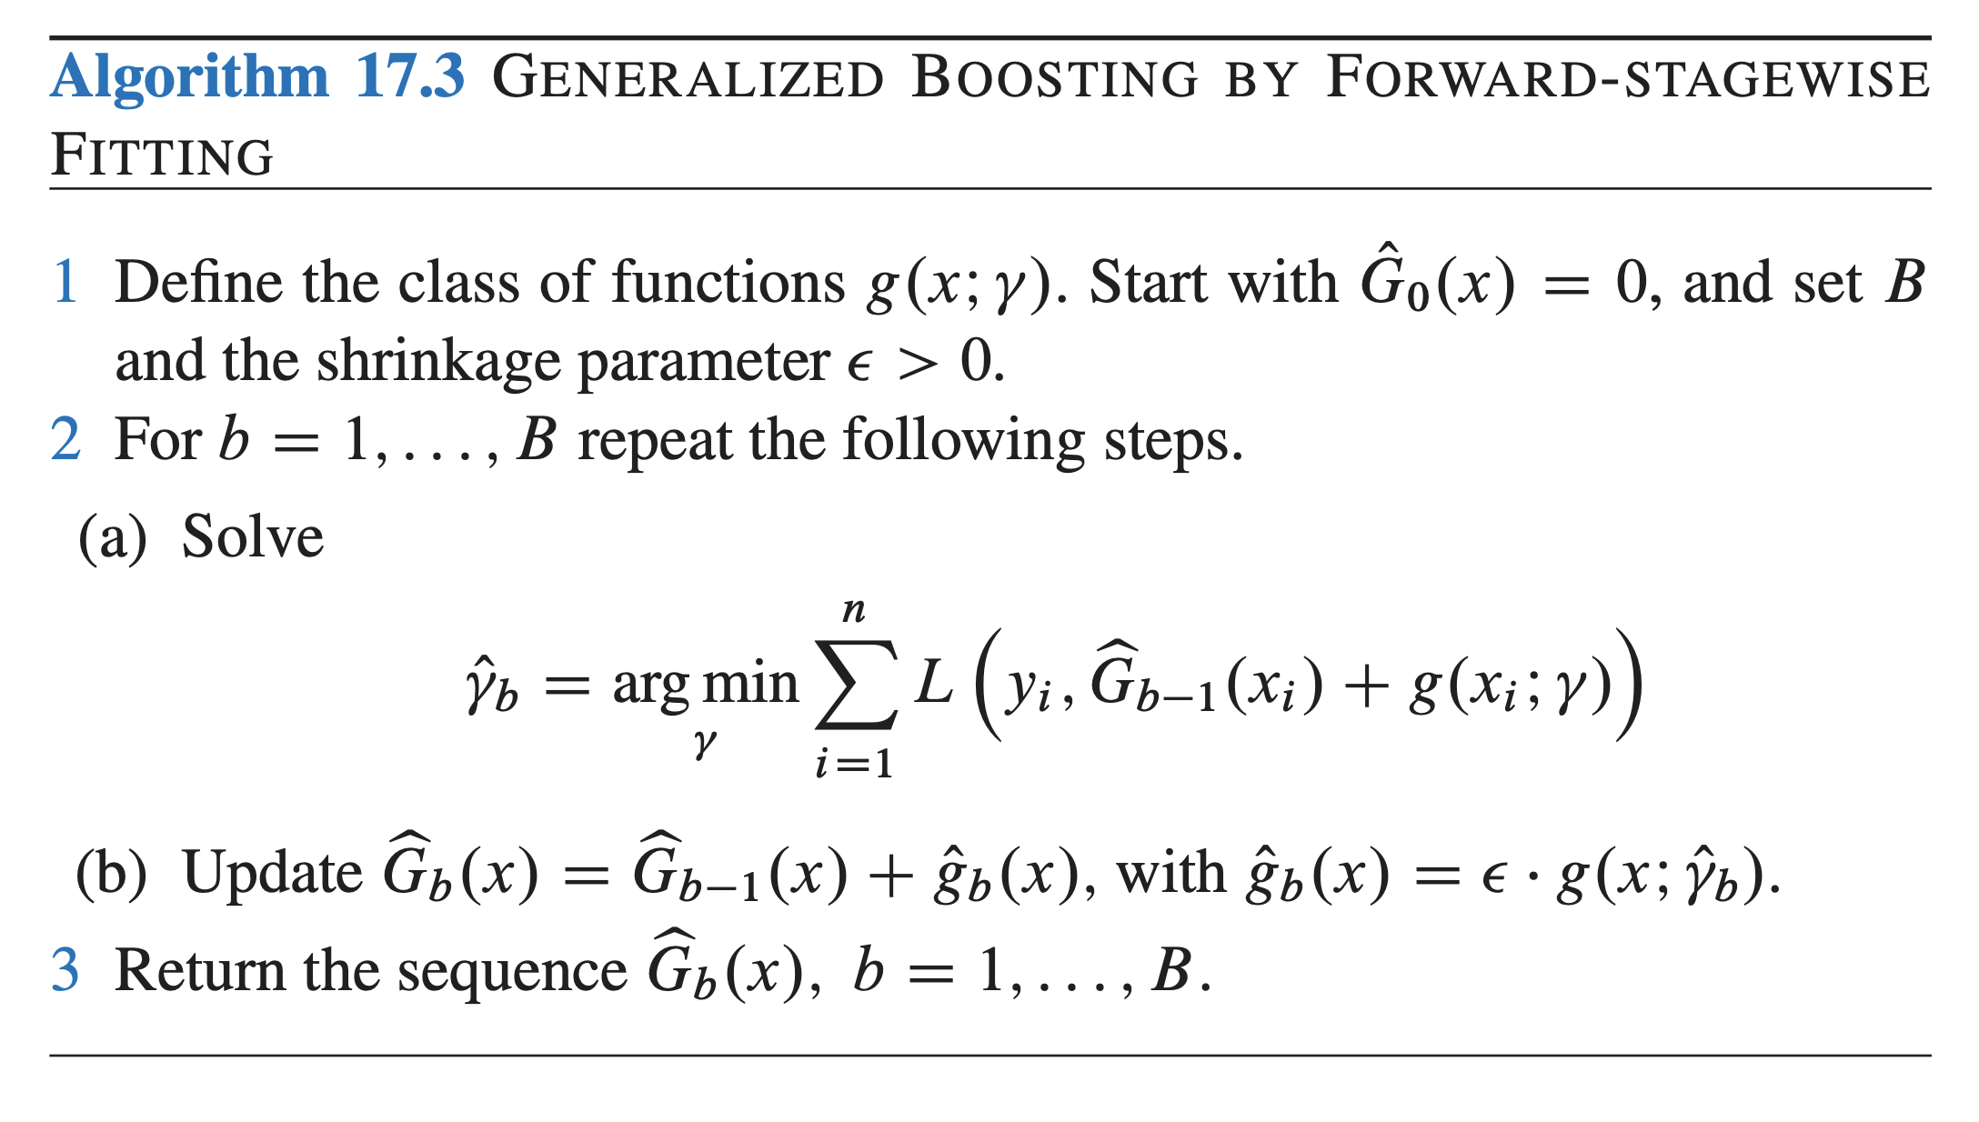
Boosting (Weak Learners)
Boosting for Non-Quantitative Responses: Minimize a loss function (typically negative log likelihood) slowly.

Slide 75
Boosting (Weak Learners)
Boosting for Non-Quantitative Responses: Intuition
At the (b-1)^{th} iteration
At iteration b, the task to is revise the parameters
so that the loss function L() goes down.
Principles of gradient descent say that
should be the negative gradient of the loss function. So, fit a model to the gradient!

Slide 76
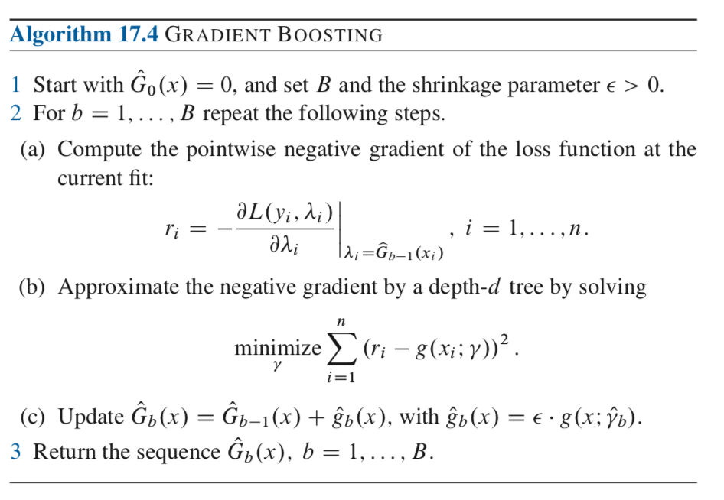
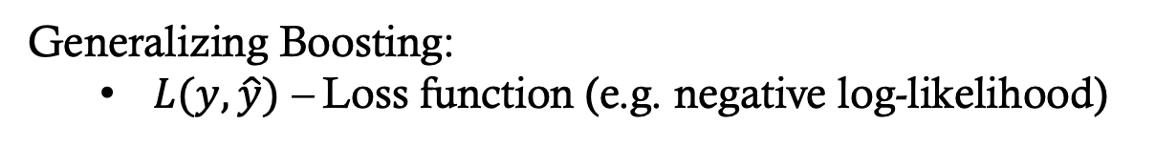
Boosting (Weak Learners)
Generalizing Boosting:
$L(y, \hat{y})$ – Loss function (e.g. negative log-likelihood)
Stochastic Gradient Boosting: Only use a percentage of data at each step (really helpful for big data and gets O-O-B error estimates)

Slide 77
Boosting (Weak Learners)
Generalizing Boosting in R:
library(gbm) #Gradient boosted trees (models)
gbm(formula=,
data=,
distribution=, # “gaussian”, “Bernoulli”, “multinomial”
shrinkage=, #lambda
n.trees=, #B
interaction.depth=, #number of splits in tree
cv.folds=K, #K-fold cross validation
bag.fraction=) #percent of data to use at each iteration

Slide 78
Boosting (Weak Learners)
Generalizing Boosting in R:
gbm.perf(gbm.obj) #plots performance by num.trees
summary(gbm.obj) #plots variable importance
predict.gbm(gbm.obj, newdata=,
n.trees, #number of trees to use (can be a vector)
type=, # “link” or “response”
single.tree= #T/F if TRUE then predicts only from n.trees)

Slide 79
Boosting (Weak Learners)
Boosting in R via xgboost:
xgboost = extreme gradient boosting is essentially boosting but with fast implementation
Tutorials:
https://xgboost.readthedocs.io/en/latest/R-package/xgboostPresentation.html
https://www.analyticsvidhya.com/blog/2016/01/xgboost-algorithm-easy-steps/

Slide 80

BART (Bayesian Additive Regression Trees)
Bagging/RF: some randomization in tree construction
Boosting: trees are built on current residuals

Slide 81
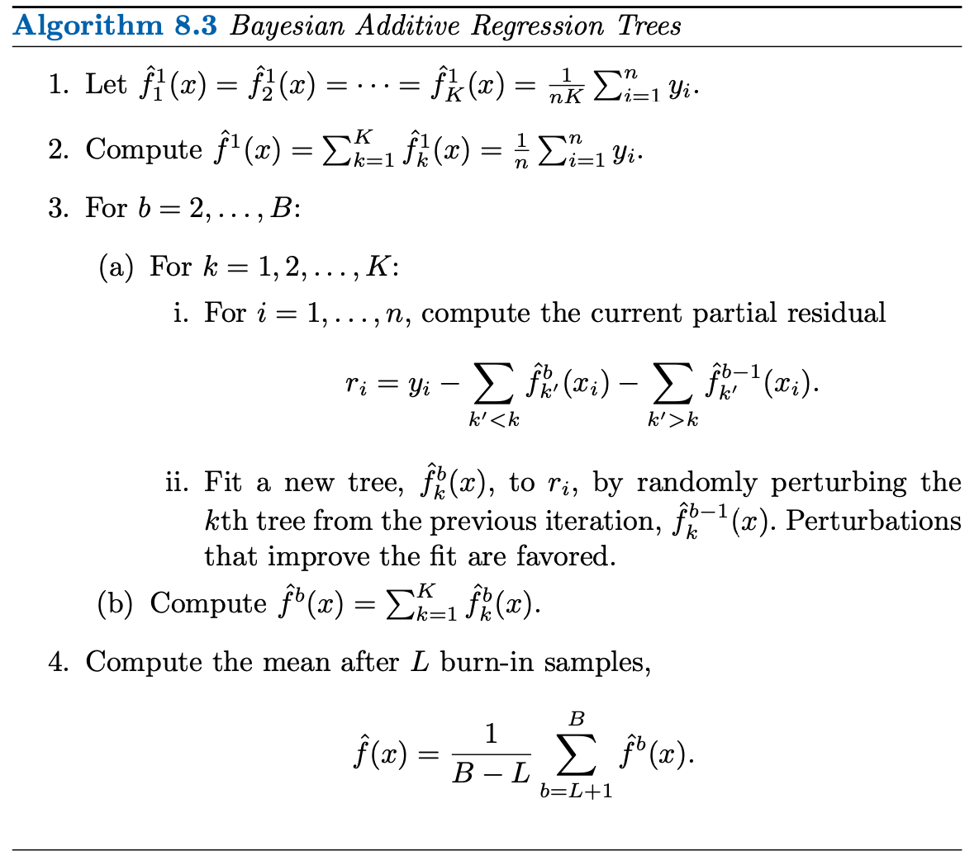
BART (Bayesian Additive Regression Trees)
Tuning parameters: K, B, and priors (not listed)
Perturbations can include changing the tree and the leaf values.
These are random – this is MCMC sampling after all

Slide 82
BART (Bayesian Additive Regression Trees)
The book uses the gbart() function in the BART package.

Slide 83
Thoughts on Ensemble Methods
Ensemble Methods = Non-interpretable.
If you’re just interested in prediction, they work great.
When possible, pursue models/techniques that not only predict pretty well but are also easy to interpret.

Slide 84
End of Gene Expression Analysis

Slide 85
Calibrating ML Probabilities
Some ML methods do not produce predictions of probabilities:
Trees = votes (biased if lop-sided data)
SVMs = distance from hyperplane
Neural Nets = Transformed linear predictor
Calibrating probabilities is the process of taking the output from these methods to produce a data-based estimate of the various class probabilities.

Slide 86
Calibrating ML Probabilities
Do I need to calibrate my probabilities? Check a reliability diagram.

Slide 87
Calibrating ML Probabilities
Platt Calibration:
glm(y~ML.output, family=binomial)
Isotonic Regression Calibration
Nonparametrically fit a non-decreasing function to ML.output by data probabilities

Slide 88
Stacking Models
“Stack” Models: Use model fits as “features” in a new model. For example, use predictions from SVM, NN, Naïve Bayes, Trees etc. as inputs into a new tree or logistic regression.

Slide 89
A Word About Cutoffs
DA, KNN, SVMs, Trees, and NNs can effectively give you probabilities of “yes” or “no”. So, all the ideas related to cut-offs from logistic regression still apply.

Slide 90
End of Admission Data Analysis

